Slide 1
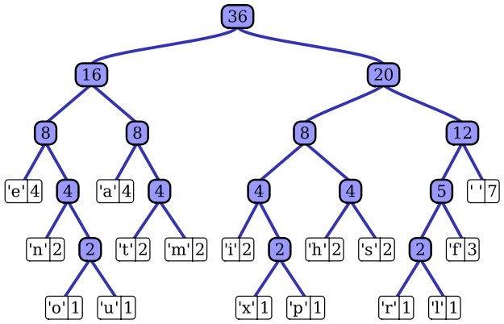
A Priority Queue to Implement Huffman Encoding
By :
Alexander Cannell
Nathan Erickson
Chris Kelly

Slide 2
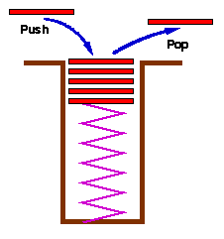
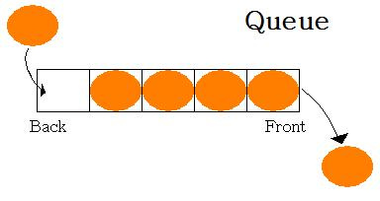
Queue
Like a Stack which is Last In - First Out where elements are pulled.
A Queues elements are pulled First In - First Out.

Slide 3
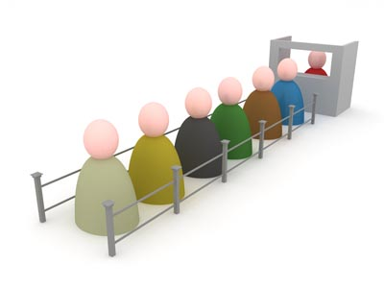
Priority Queue
A Priority Queue is an abstract data type which like a regular queue or stack data structure, but where additionally each element has a priority associated with it. The higher the priority always comes first in the queue.

Slide 4
Huffman Coding
Huffman Coding is an entropy encoding algorithm used for lossless data compression. The term refers to the use of a variable length code table for encoding a source symbol where the variable length code table has been derived in a particular way based on the estimated probability of occurrence for each possible value of the source symbol. Developed by David A Huffman PHD in 1952. "A Method for the Construction of Minimum-Redundancy Codes".

Slide 5
Huffman Coding

Slide 6
Over-Look
The Beginning
Takes Input
Splits Characters and Frequencies Using a TreeMap
Put it into the Priority Queue
Took values out of the Priority Queue Sorted by frequency (priority).
Printed the Values.
The End

Slide 7
Methods/Classes
Classes:
-TreeNode
-Huffman
Methods:
-DataGet
-Main

Slide 8
The End!
Any Questions?

